Slide 1
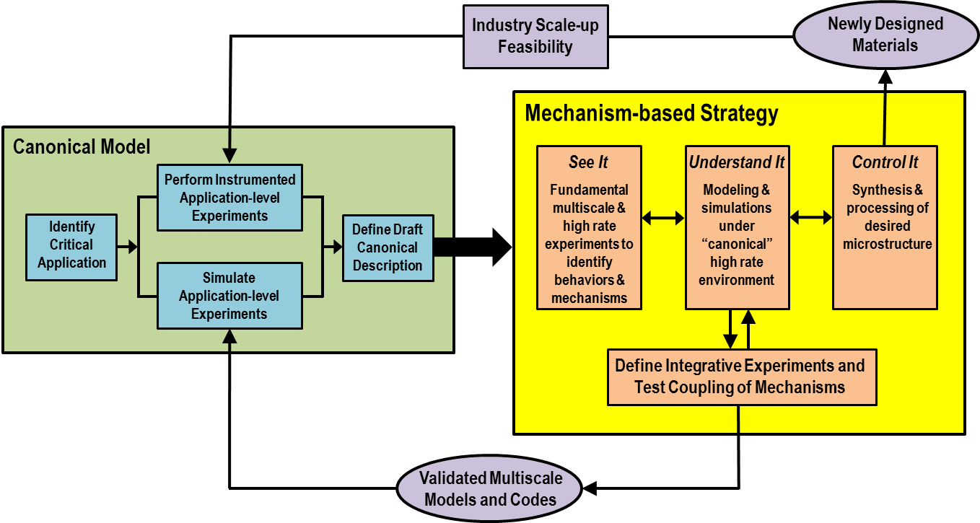
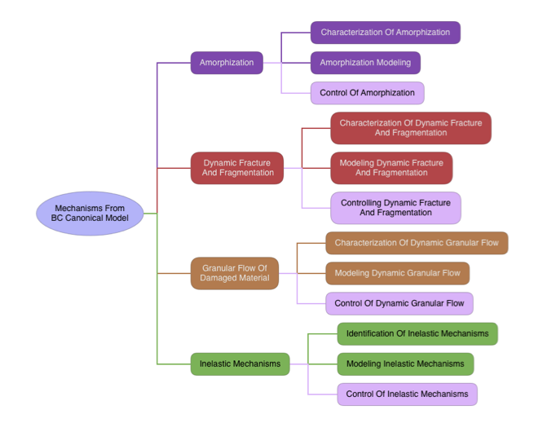
UNCLASSIFIED
Title (should match your 2016 task title)
PI and associated persons working on this task (include ARL collaborators)
How We Fit
Technical Approach
Key Accomplishments
Materials-by-Design Process
Identify where this task fits in this process
Poster author can adjust size of areas being addressed depending on content.
Future Directions in 2017
Key Goals
Major Results
Impact
UNCLASSIFIED
Insert logo of PI’s institution (JHU is an example for logo size).

