Slide 1
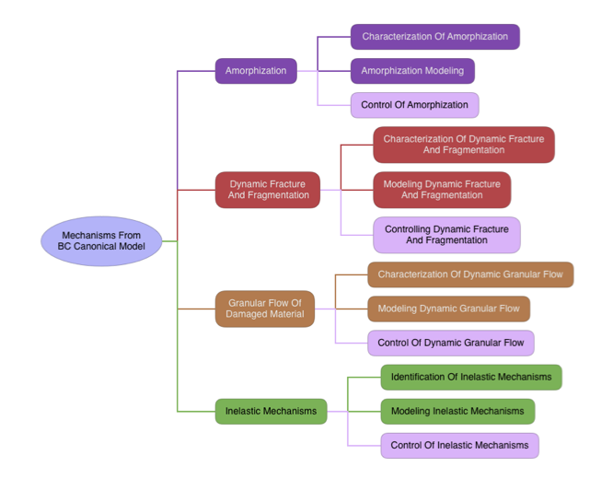
Please ensure all poster info is unclassified
Title
Title
PI/Co-PIs and collaborators working on this task (include DTRA collaborators)
RA-FA / Key Goals
Technical Approach, Key Accomplishments, and Path Forward
Identify which RA/FA this task fits in
Identify Key Goals
Major collaborations within FAs
RA1
Hufnagel
Hurley
RA2
Weihs
Zachariah
CCRI
Foster
Poster author can adjust size of areas being addressed depending on content.
RA3
Curreli
Glumac
RA3
Beg
References and/or Products
Insert logo of PI’s institution (JHU is an example for logo size).

